Slide 1
COMP23420 week 5:
GRASP design principles and inheritance
John Sargeant (johns@cs.man.ac.uk)
Notes:
Title slide

Slide 2
Customer collaboration
Agile Manifesto value: customer collaboration over contract negotiation.
Ideally, a customer representative (user) is part of the project team.
But often different users/stakeholders have different requirements
Regular demos to the customer(s) important (end of each iteration at minimum)
In the lab, for iteration 2 you will need to ask many questions.

Slide 3
GRASP principles - reminder
High cohesion – each class should represent a single well-defined entity
Low coupling – classes should not be overly dependent on each other.
Pure fabrication – add extra classes, not in the domain, to improve cohesion and coupling
Information expert – put operations in the classes which contain the information to carry them out (and vice versa).

Slide 4
GRASP: Protected variations
Design so that if something changes, the rest of the code is not badly affected, or,
Abstract the Thing Which Varies (TVV), so when the TVV varies, it doesn’t trash the rest of the code.
Example: the Java Calander and DateFormat classes protect against variations in locale by providing for different timezones, date/time formats etc.
Problem: many things can vary, it’s hard to predict which ones will matter, and you have finite effort. (See Larman pp 427-434 for a discussion).
Agile methods discourage over-generalisation.

Slide 5
GRASP: Polymorphism
Use inheritance to improve cohesion, reduce coupling, and protect against variation.
NB: in the OO community polymorphism == inheritance == generalisation. In academic CS, inheritance is just one form of polymorphism.
Inheritance used properly is very powerful – dynamic binding is often better than if-statements, but:
observation: inexperienced designers (and also some who should know better) misuse inheritance.
Important question: when is it appropriate to use inheritance?

Slide 6
Inheritance rules
Only use inheritance if:
There is a clear is-a-kind of relationship between the superclass and its subclasses.
Each of the subclasses is different in some non-trivial way from the others and from the superclass
Every object of the superclass type belongs to exactly one subclass.
NB: Inheritance is not primarily about code reuse – that can be done in other ways, primarily composition.

Slide 7
Case study - reminder
You have been hired to develop an integrated information system for the Irwell online store. They originated as a book store but now sell other forms of media such as CDs and DVDs. They also intend to branch out into selling electronic devices such as laptops and PDAs although they don’t intend to become a general store.
Initially you will develop an inventory system: an inventory lists the products a company has in stock, along with information such as prices.

Slide 8
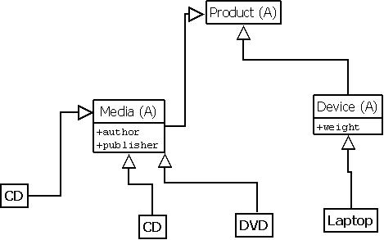
Representing products

Slide 9
Good design?
All three conditions are met
New kinds of product require new subclasses, ok provided that “they don’t intend to become a general store.”
But what if this changes? Can’t keep changing the code each time a different product appears.
Option 1: use inheritance to represent broad categories of products.
Option 2: represent product categories as a single class.

Slide 10
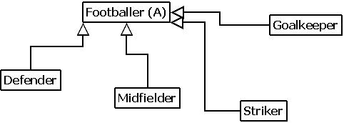
A natural example?
We could represent players in a football management game like this…

Slide 11
Inheritance and roles
What if a player plays multiple positions?
We’ve broken rule 3 – more than one software object may represent the same physical object
Results in redundancy and potential inconsistency of data – e.g. if a player changes club we need to change this information several times.
Hard to change the set of roles (positions) once the data is in place.

Slide 12
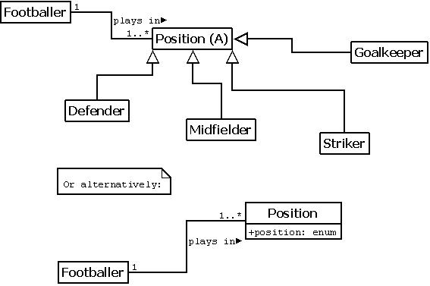
Alternatives

Slide 13
Advantages
Information about a footballer, e.g. club, is held in just one object
Roles (positions) can change over time
New positions can easily be added, and made more fine-grain (e.g. wing-back).
Code using the Footballer class is decoupled from how position is represented – so easy to switch between the two alternatives.
Generally better to start with the simple design, and introduce inheritance if needed later.

Slide 14
GRASP Creator principle
Guidelines for where to create objects
A special case of Information Expert
Find an existing class which has the information required to create instances of another class.
See Larman for the full list of suggestions
When creating objects from persistent storage, it’s often a good idea to create objects of class X within class X, via a static method.
Sometimes, can’t be applied, because no existing class is suitable.

Slide 15
Indirect object creation
Creating objects:
new ConcreteClassName(actual parameters)
is the weak link in encapsulation. We have to provide an actual concrete class name, and actual parameters.
Often best to create objects indirectly, e.g. we use getGraphics() to get an instance of the (abstract) java.awt.Graphics class.

Slide 16
Factories
A factory is a class whose sole purpose is to create objects of other classes
An alternative to Creator when object creation is complex, or dependent on external factors (e.g. platform dependencies)
Example: a FontFactory which gets the best approximation to a font with a particular description on a particular platform.
The objects to be created can be specified in many ways, e.g. via a config file.
Factories can implement caching and other object-management functions.

Slide 17
Factories and GRASP
Factories are Pure Fabrications
They are also information experts, they contain, or have access to, the information needed to create objects.
They decouple object creation from the code that uses those objects…
… thereby improving the cohesion of both.
Like any other technique, factories are not always applicable – often creating objects directly (Creator) is fine.

Slide 18
Controllers
A PF which mediates between the UI (view) and the business logic (model)
Only apply if there is genuine complexity in one or both of the above.
Needs to be organised systematically.
Common organisations are a Use Case controller (one per use case) or a Facade controller (one for the whole system).
Remember: MVC is optional, model-view separation is compulsory.

Slide 19
Assorted design tips
Do everything in exactly one place.
Keep classes and methods small.
Start with the simplest design which can possibly work – you can always embellish it afterwards
Assume that the requirements will change during (and quite possibly as a result of) design
Refactor early and often.
Inspect and think about designs of experienced designers.
Learn about design patterns (see Larman and COMP33411).

Slide 20
Things to think about
Think of half a dozen possible uses of inheritance, and go through them to decide whether they are good ones or not.
In Java (unlike e.g. C++) you can only inherit implementation from one class. Can you think of an example where you would really want to extend more than one class?
If the Irwell online store had too many products for there to be a class for each one, what would be the consequences of the two options given on slide 9?
Apart from the FontFactory example given, what other examples can you think of where a Factory could be useful?

Slide 21
Questions?

Slide 22
GRASP summary (1)
There are 9 GRASP principles in total of which three are fundamental:
High cohesion – every class should represent a single well-defined entity.
Low coupling – the number and complexity of dependencies between classes, and between subsystems, should be minimised.
Protected variations – design in such a way that the impact of changes on the code is minimised (not possible without high cohesion and low coupling).

Slide 23
GRASP summary (2)
The other GRASP principles are ways of achieving 1-3:
Pure Fabrication: add a class not in the domain to improve C,C, and PV (e.g. a Factory)
Polymorphism: use inheritance (wisely) to improve C,C and PV (especially PV)
Indirection: add a level of indirection to improve C, C, and PV (especially coupling).

Slide 24
GRASP summary (3)
7. (Information) Expert: put an operation in the class which has the information to carry out that operation, and vice-versa, primarily to improve cohesion.
8. Creator: a special case of Expert where the operation is object creation.
9. Controller: a special case of Indirection, decoupling model and view.

